Slide 1
Generalized Linear Mixed Models
NRES 776
Nov 2-4, 2021

Slide 2
Learning Objectives
Explain the difference between a glm and a glmm
Decide whether an effect is fixed or random
Determine how to specify random effects
Interpret the output from a glmm
Check the assumptions of a glmm

Slide 3
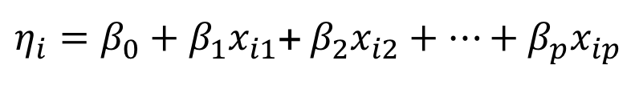


Three components of GLMs
systematic component (linear predictor)
$η_{i}=β_{0}+β_{1}x_{i1}$+ $β_{2}x_{i2}+…+β_{p}x_{ip}$
link function
$${g\left(μ_{i}\right)=η}_{i}$$
random component (variance function)
$$var\left(y_{i}\right)= φV(μ_{i})$$
dispersion parameter
Notes:
systematic component: linear function of categorical and/or numeric variables which describe the response
link function: a link function that describes how the mean, E(Yi) = µi , depends on the linear predictor
random component: describes how the variance depends on the mean

Slide 4
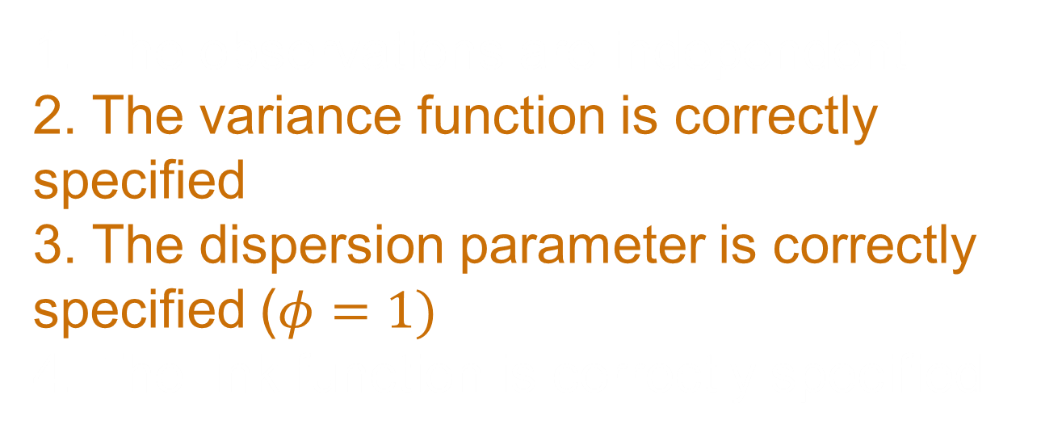
Assumptions
1. The observations are independent
2. The variance function is correctly specified
3. The dispersion parameter is correctly specified ($φ=1)$
4. The link function is correctly specified
Notes:
check book for confidence interval of intercept

Slide 5
Generalized Linear Mixed Models
Accommodate normal and non-normal error structures (e.g., Poisson, binomial, negative binomial)
Include both fixed and random effects

Slide 6
Mixed Models
Fixed:
Random:

Slide 7
Mixed Models
Fixed: levels of a factor (treatment, group) are fixed and of direct interest
e.g., sex, age (juvenile, subadult, adult), treatment
Random:

Slide 8
Mixed Models
Fixed: levels of a factor (treatment, group) are fixed and of direct interest
e.g., sex, age (juvenile, subadult, adult), treatment
Random: levels of a factor are a random sample from a population of possible levels
e.g., year, individual, site

Slide 9
Mixed Models
Fixed: levels of a factor (treatment, group) are fixed and of direct interest
e.g., sex, age (juvenile, subadult, adult), treatment
Random: levels of a factor are a random sample from a population of possible levels
e.g., year, individual, site
Mixed effects: combine fixed and random effects in the same model

Slide 10
Example Study Designs with Random Effects
Plots along streams within watersheds
Blocks
Repeat measurements on the same individuals over time
Repeat samples that are spatially correlated (samples collected closer together are more likely to be similar than samples collected farther away)

Slide 11
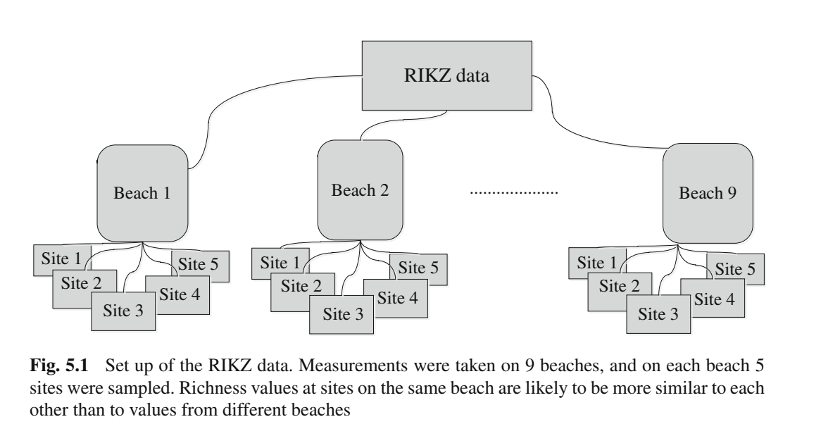
Example: RIKZ Data
Notes:
-stations nested within beaches

Slide 12
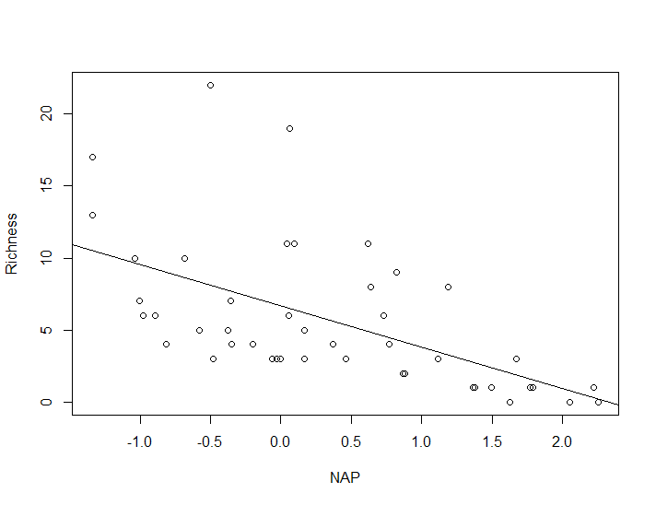
Simple Regression Model

Slide 13
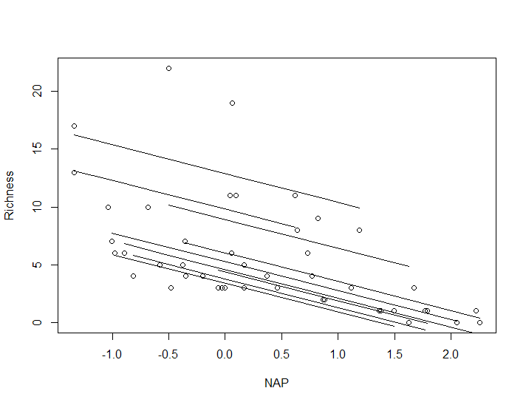
Types of Random Effects
Random Intercept
Notes:
Species richness differs at NAP = 0 for each beach

Slide 14
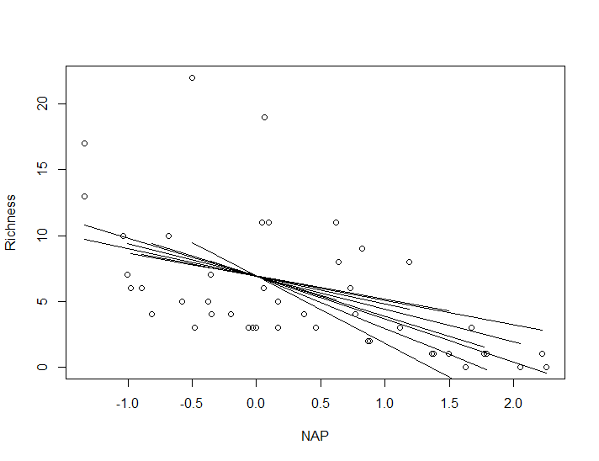
Types of Random Effects
Random slope
Notes:
The relationship between NAP and richness differs at each beach

Slide 15
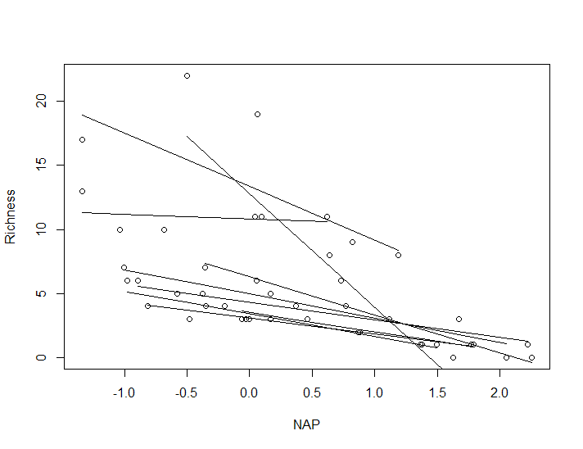
Types of Random Effects
Random intercept and slope
Notes:
Richness at NAP = 0 differs among beaches and the relationship between NAP and Richness also differs

Slide 16
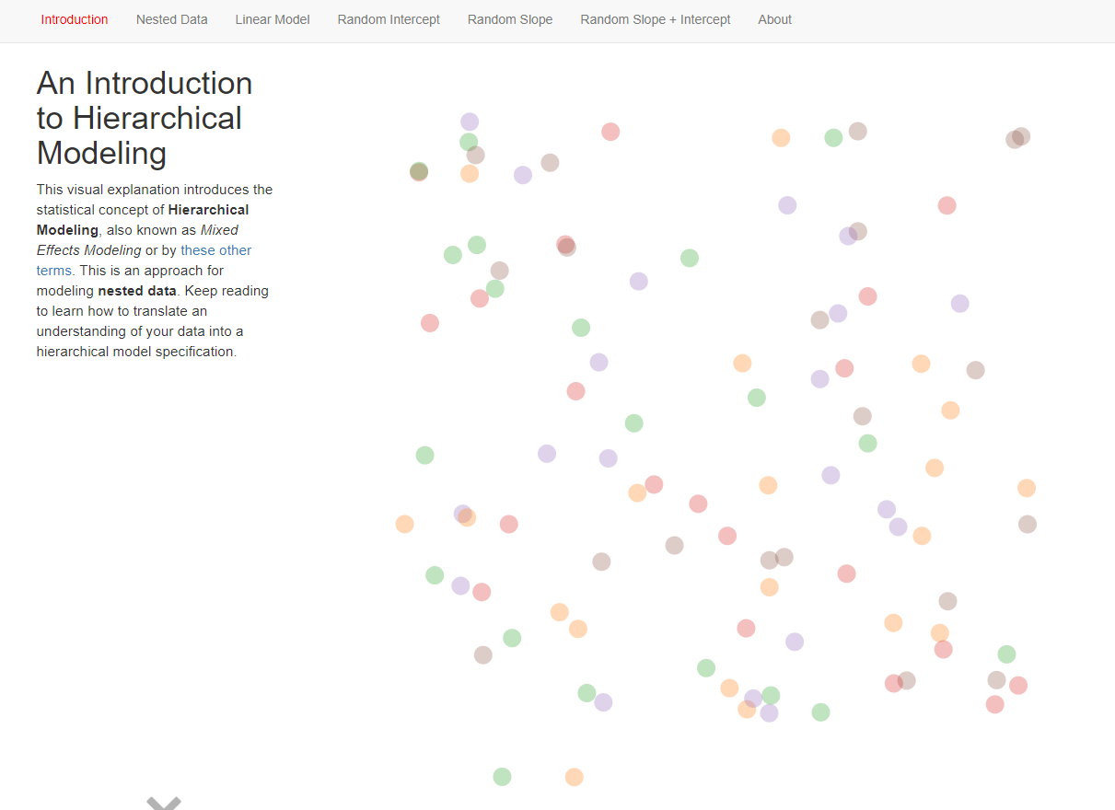
Visualization of random effects
http://mfviz.com/hierarchical-models/
Notes:
Richness at NAP = 0 differs among beaches and the relationship between NAP and Richness also differs

Slide 17
Nested vs. crossed random effects
Woodland A
Woodland B
Individual
Notes:
Can have different types of random effects

Slide 18
Nested vs. crossed random effects
Woodland A
Woodland B
Female 4
Female 5
Female 6
Female 1
Female 2
Female 3
Individual
Notes:
Can have different types of random effects

Slide 19
Nested vs. crossed random effects
Woodland A
Woodland B
Female 4
Female 5
Female 6
Female 1
Female 2
Female 3
Clutch 1
Clutch 1
Clutch 1
Individual
Clutch 1
Clutch 1
Clutch 1
Clutch 3
Clutch 3
Clutch 2
Clutch 2
Clutch 2
Clutch 2
Notes:
Can have different types of random effects

Slide 20
Nested vs. crossed random effects
Nested:
Woodland A
Woodland B
Female 4
Female 5
Female 6
Female 1
Female 2
Female 3
Clutch 1
Clutch 1
Clutch 1
Individual
Clutch 1
Clutch 1
Clutch 1
Clutch 3
Clutch 3
Clutch 2
Clutch 2
Clutch 2
Clutch 2
Notes:
Can have different types of random effects

Slide 21
Nested vs. crossed random effects
Years 1-3
Woodland A
Woodland B
Female 4
Female 5
Female 6
Female 1
Female 2
Female 3
Clutch 1
Clutch 1
Clutch 1
Individual
Clutch 1
Clutch 1
Clutch 1
Clutch 3
Clutch 3
Clutch 2
Clutch 2
Clutch 2
Clutch 2
Notes:
Can have different types of random effects

Slide 22
Nested vs. crossed random effects
Crossed
Years 1-3
Woodland A
Woodland B
Female 4
Female 5
Female 6
Female 1
Female 2
Female 3
Clutch 1
Clutch 1
Clutch 1
Individual
Clutch 1
Clutch 1
Clutch 1
Clutch 3
Clutch 3
Clutch 2
Clutch 2
Clutch 2
Clutch 2
Notes:
Can have different types of random effects

Slide 23
Why use random effects
Control for non-independence among data points
Notes:
Most common use of a random effect is to control for non-independence of data points
most complex ecological data sets include nested or crossed designs
These often generates measurements within a groups (e.g. individual) that are not independent, violating the assumptions of general and generalized linear models
if non-independence of data points is not accounted for, SE of model coefficients will be artificially low, increasing the chance of Type I error.
The most common way of accounting for non-independence of data points is by fitting a GLMM where the intercept is allowed to vary by group (e.g. individual)

Slide 24
Why use random effects
Control for non-independence among data points
Estimate variance components

Slide 25
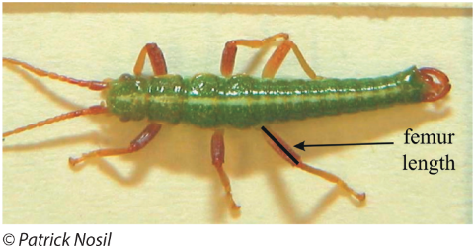




Why use random effects
Control for non-independence among data points
Estimate variance components (e.g., Repeatability)
$$γ_{j} \sim Normal(0,σ_{γ}^{2})$$
$$ε_{i} \sim Normal(0,σ_{ε}^{2})$$
among group variance
(variability in the intercept)
within group variance
(residual)
$$R_{M}=\frac{σ_{γ}^{2}}{σ_{γ}^{2}+σ_{ε}^{2}}$$
less variability among groups
(less repeatability)
more variability among groups
(more repeatability)
$0{≤R}_{M} ≤$ 1

Slide 26
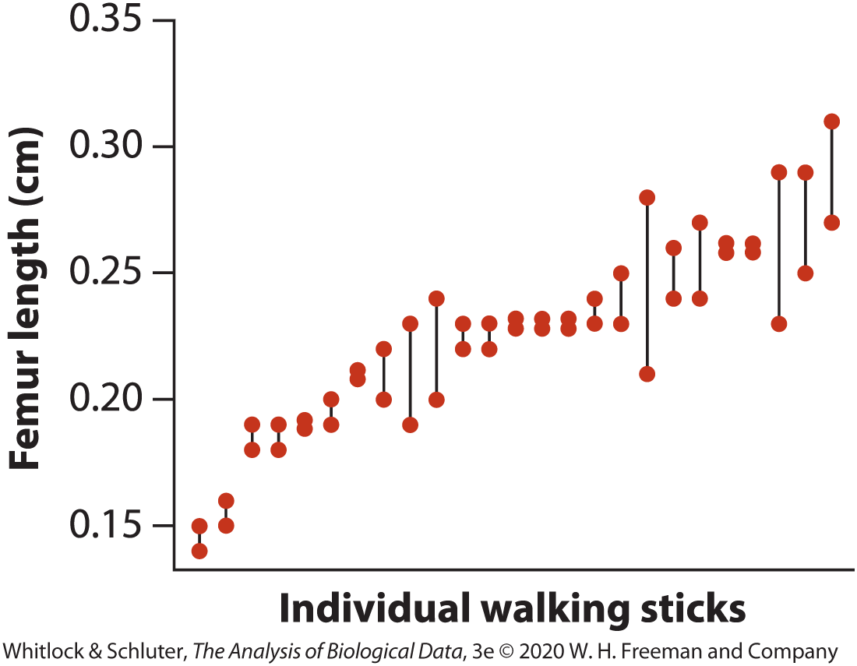
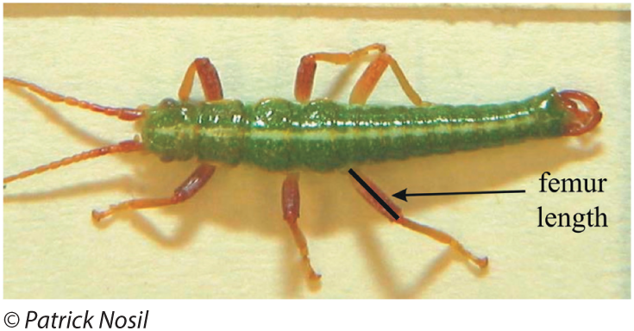
Estimating variance components

Slide 27
Why use random effects
Control for non-independence among data points
Estimate variance components (e.g., Repeatability)
$$γ_{j} \sim Normal(0,σ_{γ}^{2})$$
$$ε_{i} \sim Normal(0,σ_{ε}^{2})$$
among group variance
(variability in the intercept)
within group variance
(residual)
$$R_{M}=\frac{σ_{γ}^{2}}{σ_{γ}^{2}+σ_{ε}^{2}}$$
less variability among groups
(less repeatability)
more variability among groups
(more repeatability)
$0{≤R}_{M} ≤$ 1

Slide 28
Why use random effects
Control for non-independence among data points
Estimate variance components (e.g., Repeatability)
Improve the accuracy of parameter estimation Useful visualization:
https://m-clark.github.io/posts/2019-05-14-shrinkage-in-mixed-models/#:~:text=sigma%20%3D%20.25)-,Summary,when%20there%20is%20little%20information.
Notes:
Assuming all group means (deviation from intercept in a random intercept model) comes from a common normal distribution will cause the estimates of those means to drift toward the global mean (i.e. the mean across all groups)
This phenomenon is called shrinkage and leads to more accurate and precise estimates of groups means.
Groups with large sample size will drift less toward the global mean, whereas shrinkage will be strongest for groups with smaller sample sizes, as there will be less information on the data bout the group mean. In a sense, estimates for data poor groups will be borrowing information from data rich groups.

Slide 29
Why use random effects
Control for non-independence among data points
Estimate variance components (e.g., Repeatability)
Improve the accuracy of parameter estimation
Make inference for groups (e.g., individuals) not measured
Notes:
Models where factors are treated as fixed cannot be used to make predictions for other levels of the factor not included in the analyses because the estimates are only relevant to the levels of the factor included in the dataset.
By treating a factor as random, one can use the global mean as a prediction for a level of the factor not included in the analysis.

Slide 30
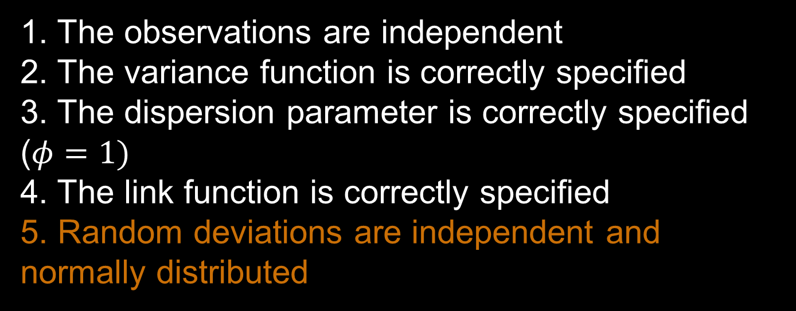
Assumptions
1. The observations are independent
2. The variance function is correctly specified
3. The dispersion parameter is correctly specified ($φ=1)$
4. The link function is correctly specified
5. Random deviations are independent and normally distributed

Slide 31
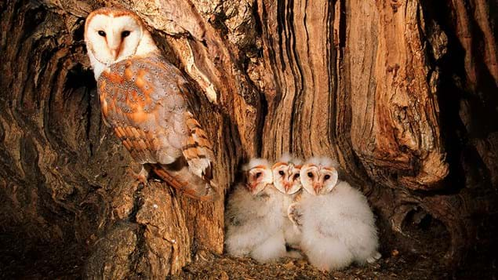
Example: Begging behaviour in nestling barn owls
Notes:
Image: Mike Read / naturepl.com
Data: Roulin and Bersier (2007)
Analysis: Zuur et al. 2009. Mixed effects models and extensions in R. Chapter 6, section 6.3.
-how do nestlings respond to the presence of the father and mother?
-placed microphones inside the nest box and videos outside
-looked at vocal begging behaviour when parents brought prey
-27 nests, 2-7 nestlings per nest
-response variable was sibling negotiation: number of calls made by offspring in the 15 min before arrival of a parent divided by the number of offspring (recorded in 30-s intervals)
-explanatory variables: sex of parent, treatment of food (food added or not), arrival time of parent
-food treatment swapped on second night

Slide 32
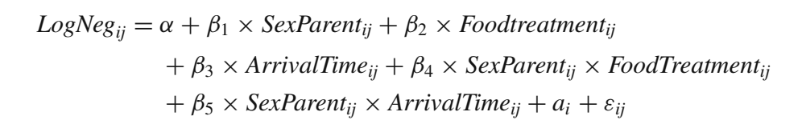
Example: Begging behaviour in nestling barn owls
Notes:
Section 5.10

Slide 33
Example: Begging behaviour in nestling barn owls
Notes:
Log neg = log-10 transformed sibling negotiation for observation j at nest i

Slide 34
Example: Begging behaviour in nestling barn owls
Notes:
Sexparent = 2-level variable
Food treatment = 2-level variable
Arrival time = continuous variable

Slide 35
Example: Begging behaviour in nestling barn owls
Notes:
Design:

Slide 36


Example: Begging behaviour in nestling barn owls
$$γ_{j} \sim Normal(0,σ_{γ}^{2})$$
$$ε_{i} \sim Normal(0,σ_{ε}^{2})$$
Notes:
a_i is a random intercept for each nest, normally distributed with variance sigma squared
Residual error is also normally distributed with mean of 0 and variance sigma squared

Slide 37
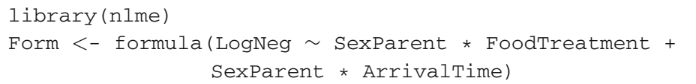
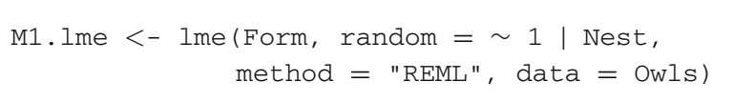
Fit Model with Restricted Maximum Likelihood
Notes:
Maximum likelihood estimation for generalized linear models: determine the parameters that maximize the probability (likelihood) of the same data
REML estimates the random-intercept variance taking into account the loss of 1 df resulting from the estimation of the overall mean

Slide 38
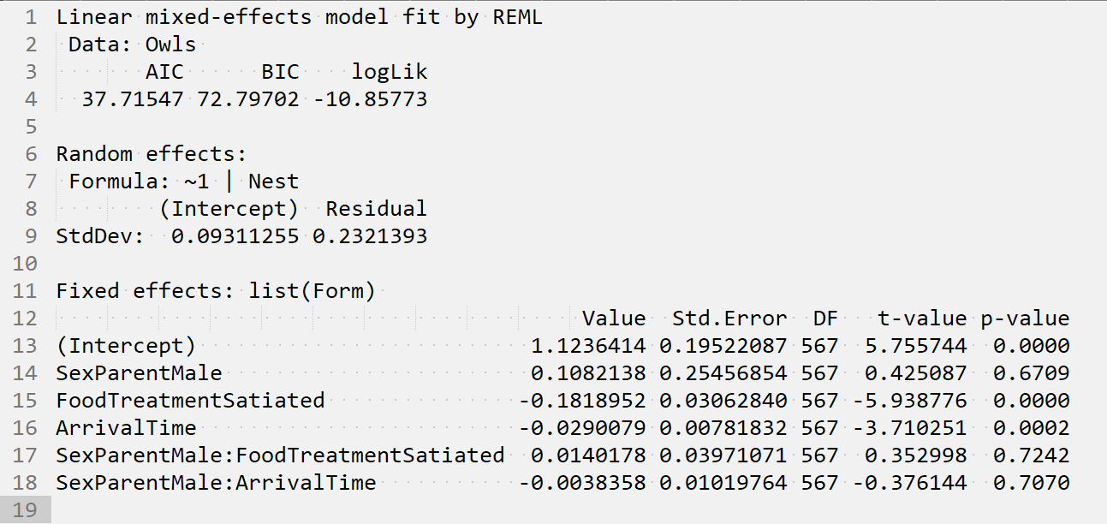
Interpreting Model Results
Notes:
Random effects:
StdDev for the intercept tells us that the random intercept (a_i) is normally distributed with a mean of 0 and variance of 0.9^2
StDev of the Residual tells us that the residual error (e_ij) is normally distributed with mean 0 and variance 0.23^2.
No parameter estimates for random effects

Slide 39
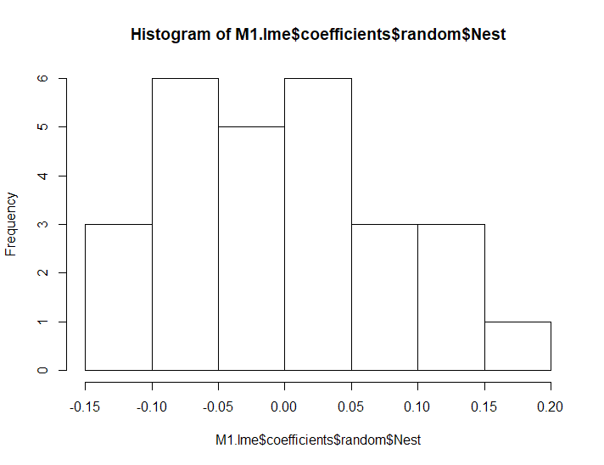
Checking Assumptions: Are random effects normally distributed?
Notes:
If you also have a random slope, you would need to look at normality of the random slope as well

Slide 40
Summary
Generalized linear mixed models can accommodate both fixed and random effects in addition to non-normal error structures
Random effects can be incorporated as random intercepts, random slopes, or random intercept and slopes
Random effects may be nested or crossed
With mixed models, need to check assumption that random deviations are independent and normally distributed
Mixed effects models are fit with restricted maximum likelihood

